Slide 1
US06CMIC21
Molecular Biology
Unit: 3: Genetic engineering-I
Outline of Gene cloning
Biotechnology: The biological principles, M.D. Trevan and Gould.
11th reprint 2002 Page no.118-119
Isolation of DNA and RNA.
Practical Biochemistry: Principles and Techniques – K. Wilson
and Walker, 5th Edition, (Cambridge low price edition)
Page no.105-108
Enzymes and steps in gene cloning:
(1) Restriction Endonucleases: Types, nomenclature, recognition
sequences and cleavage pattern
(2) DNA ligase and ligation
(3) Modifications of cut ends
B.D. Singh B.Sc edition , Kalyani publishers
(1) Page no.12 to 19 (2) & (3) Page no.62-65

Slide 2
DNA sequencing : Maxam Gilbert and Sanger sequencing
B.D. Singh B.Sc edition , Kalyani publishers
Page no. 84 to 87
Salient features of ideal vector.
B.D. Singh B.Sc edition , Kalyani publishers
Page no. 38 to 39
Vectors used in genetic engineering.
Principles of Molecular Biology by Veer Bala Rastogi 2nd edition
Plasmids(PBR 322, PUC 18) Page no. 373-374
Bacteriophages : lambda, Page no. 375
Cosmids, Page no. 376
Artificial chromosome vectors: YAC and BAC Page no. 378-380
C-DNA library preparation
B.D. Singh B.Sc edition , Kalyani publishers
Page no. 20 to 21 Figure on Page no.20

Slide 3
Outline of gene cloning
Gene cloning was initially made possible by technical
developments, such a isolation of enzymes which would cut DNA
at precisely defined locations (restriction endonuclease), or those
which would covalently join DNA fragments (ligases), and
advances still often depend the development of new enzymes or
other biochemical.
We are experiencing an explosion in the publication of new
techniques related to cloning, and this proliferation of technical
information, combined with an extend jargon, can easily blind
the novice to the basic principles of cloning.
Once these are understood, it is much easier to see where new
techniques fit in to the cloning process.
The aim of this section is to outline the strategies employed for
gene cloning, and so introduce those techniques which are most
commonly used.

Slide 4
There are several possible reasons for wishing to clone a
particular piece of DNA. One might wish to introduce into
bacterial cells a gene coding for a valuable polypeptide, in such a
way that the cells would produce large amounts of the
polypeptide.
This is the approach which has received most publicity, resulting
in the production by bacteria of such polypeptides as insulin,
interferon and growth hormone.
As will be seen later, DNA can also be cloned in eukaryotic cells,
with the aim either of using the cells as biochemical 'factories', or
in order to modify the properties of the cell to mastake them
better suited to our needs.
However, in practice gene cloning is carried out most often to
produce enough DNA for subsequent analysis by, for example,
sequencing.

Slide 5
Gene cloning is essentially the insertion of a specific piece of
foreign DNA into a cell, in such a way that the inserted DNA is
replicated and handed on to daughter cells during cell division.
This process occurs naturally, as demonstrated by the rapid
spread of multiple resistance to antibiotics through populations
of bacteria under the appropriate selective pressure. However,
transfer of DNA normally occurs only between closely related
strains of bacteria, and there is little control over which DNA
fragments are transferred.
The main steps of gene cloning are as follow:
Isolation of the gene (or other piece of DNA) to be cloned.
Insertion of the gene into another piece of DNA, called a vector, which will allow it to be taken up by bacteria and replicated within them as the cells grow and divide.
Transfer of the recombinant vectors into bacterial cells, either by transformation or by infection using viruses

Slide 6
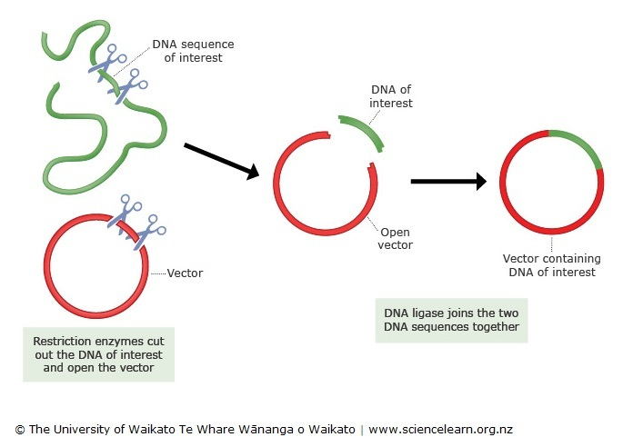
Selection of those cells which contain the desired recombinant
vectors
(5) Growth of the bacteria; this can be continued indefinitely, to give as much cloned DNA as is needed.

Slide 7
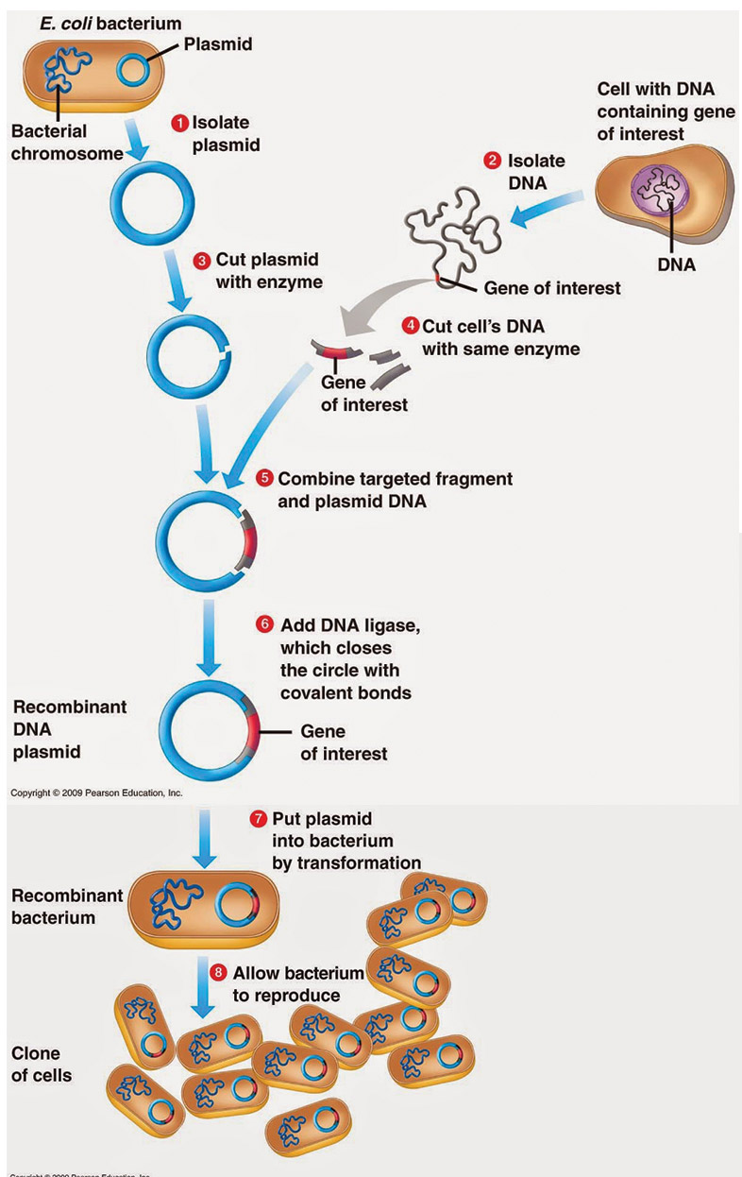

Slide 8
For Gene Cloning Following topics we have to understand:
(1) Isolation of DNA and RNA
(2) Restriction Endonucleases: Types, nomenclature, recognition
sequences and cleavage pattern
(3) DNA ligase and ligation
(4) Modifications of cut ends
(5) DNA sequencing : Maxam Gilbert and Sanger sequencing
(6) Salient features of ideal vector.
(7) Vectors used in genetic engineering.
Plasmids(PBR 322, PUC 18)
Bacteriophages : lambda
Cosmids
Artificial chromosome vectors: YAC and BAC
(8) C-DNA library preparation

Slide 9
Isolation of DNA
The use of DNA for analysis or manipulation usually requires that
it is isolated and purified to a certain extent.
DNA is recovered from cells by the gentlest possible method of
cell rupture to prevent the DNA from fragmenting by mechanical
shearing.
This is usually carried out in the presence of EDTA which chelates
the Mg²⁺ ions needed for enzymes that degrade DNA termed
DNase.
Ideally, cell walls, if present, should be digested enzymatically (eg.
lysozyme treatment of bacteria), and the cell membrane should
be solubilised using detergent. If physical disruption is necessary,
it should be kept to a minimum, and should involve cutting or
squashing of cells, rather than the use of shear forces.
Cell disruption (and most subsequent steps) should be per formed
at 4°C, using glassware and solutions that have been autoclaved
to destroy DNase activity.

Slide 10
After release of nucleic acids from the cells, RNA can be removed
by treatment with ribonuclease (RNase) that has been heat-
treated to inactivate any DNase contaminants; RNase is relatively
stable to heat as a result of its disulphide bonds, which ensure
rapid renaturation of the molecule on cooling.
The other major contaminant, protein, is removed by shaking the
solution gently with water-saturated phenol, or with a
phenol/chloroform mixture, either of which will denature
proteins but not nucleic acids.
Centrifugation of the emulsion formed by this mixing produces a
lower, organic phase, separated from the upper, aqueous phase
by an interface of denatured protein.
The aqueous solution is recovered and deproteinised repeatedly,
until no more material is seen at the interface. Finally, the
deproteinised DNA preparation is mixed with two volumes of
absolute ethanol, and the DNA allowed to precipitate out of
solution in a freezer.

Slide 11
After centrifugation, the DNA pellet is redissolved in a buffer
containing EDTA to inactivate any DNase present. This solution
can be stored at 4 ̊C for at least a month.
DNA solutions can be stored frozen although repeated freezing
and thawing tends to damage long DNA molecules by shearing.
The procedure described above is suitable for total cellular DNA.
If the DNA from a specific organelle or viral particle is needed, it
is best to isolate the organelle or virus before extracting its DNA,
since the recovery of a particular type of DNA from a mixture is
usually rather difficult.
Where a high degree of purity is required DNA may be subjected
to density gradient ultracentrifugation through caesium chloride
which is particularly useful for the preparation of plasmid DNA.
It is possible to check the integrity of the DNA by agarose gel
electrophoresis and determine the concentration of the DNA by
using the fact that 1 absorbance unit equates to
50 x A₂₆₀ = Concentration of DNA sample (ug ml⁻¹).

Slide 12
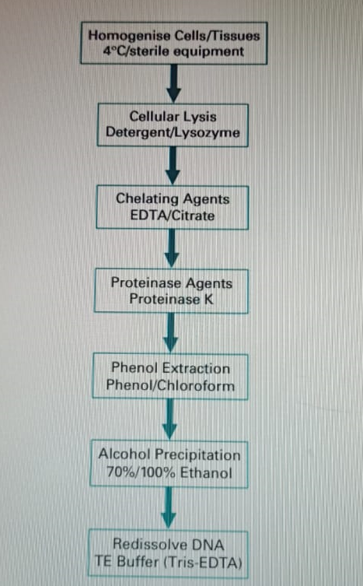
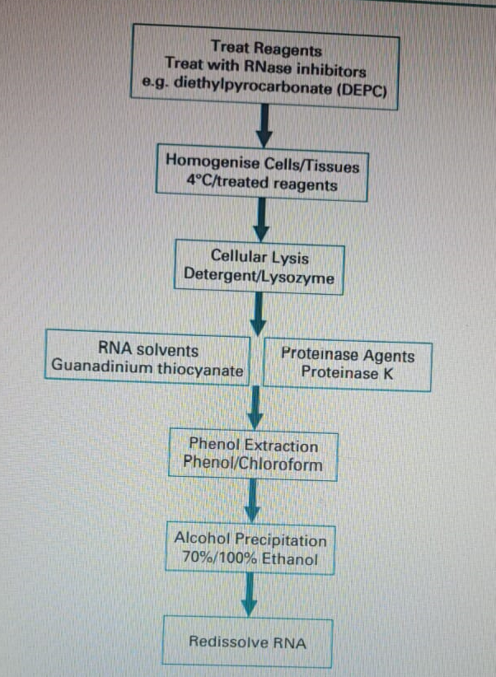
Isolation of DNA
Isolation of RNA

Slide 13
Isolation of RNA
The methods used for RNA isolation are very similar to those
described above for DNA.
However, RNA molecules are relatively short, and therefore less
easily damaged by shearing, so cell disruption can be rather
more vigorous.
RNA is, however, very vulnerable to digestion by RNases which
are present endogenously in various concentrations in certain
cell types and exogenously on fingers, Gloves should therefore
be worm, and a strong detergent should be included in the
isolation medium to immediately denature any RNases.
Subsequent deproteinisation should be particularly rigorous,
since RNA is often tightly associated with proteins.
DNase treatment can be used to remove DNA, and RNA can be
precipitated by ethanol. One reagent in particular which is
commonly used in RNA extraction is guanadinium thiocyanate
which is both a strong inhibitor of RNase and a protein denaturant.

Slide 14
It is possible to check the integrity of an RNA extract by analyzing
it by agarose gel electrophoresis. The most abundant RNA
species, the r RNA molecules 23S and 16S for prokaryotes and
18S and 28S for eukaryotes, appear as discrete bands on the
agarose gel and thus indicate that the other RNA components are
likely to be intact. This is usually carried out under denaturing
conditions to prevent secondary structure formation in the RNA.
The concentration of the RNA may be estimated by using UV
spectrophotometry. At 260 nm 1 absorbance unit equates to 40
ug ml⁻¹ of RNA therefore:
40 x A₂₆₀ = Concentration of DNA sample (ug ml⁻¹)
In many cases it is desirable to isolate eukaryotic mRNA which
constitutes only2-5% of cellular RNA from a mixture of total RNA
molecules. This may be carried out by affinity chromatography on
oligo(dT)-cellulose columns.

Slide 15
Restriction Endonucleases:
Types, nomenclature, recognition sequences and cleavage pattern
“ Endonucleases are enzymes that produce internal cuts, called
cleavage, in DNA molecules”
Many endonucleases cleave DNA molecules at random sites. But
a class of endonucleases cleaves DNA only within or near those
sites, which have specific base sequences, such endonucleases
are known as restriction endonucleases, and the sites recognized
by them are called recognition sequences or recognition sites.
The recognition sequences are different and specific for the
different restriction endonucleases or restriction enzymes.
Restriction enzymes were discovered due to and named after the
phenomenon of host restriction of bacterial phages.

Slide 16
The presence of restriction enzymes was postulated by W. Arber
during 1960s, while the first true restriction endonuclease was
isolated in 1970.
Smith, Nathans and Arber were awarded the Nobel Prize for
Physiology and Medicine in 1978 for the discovery of
endonucleases.
“ Restriction endonucleases are indispensable for DNA cloning
and sequencing. They serve as the tools for cutting DNA
molecules at predetermined sites, which is the basic
requirement for gene cloning or recombinant DNA technology”
Types of Restriction Endonucleases
There are three distinct types of restriction endonucleases.
Type I restriction endonucleases are complex endonucleases,
and have recognition sequences of about 15 bp: they cleave the DNA about 1000 bp away from the 5'-end of the sequence "TCA" located within the recognition site, e.g.. EcoK, EcoB etc.

Slide 17
Type II restriction endonucleases are remarkably stable and induce cleavage either, in most cases, within their recognition sequences or very close to them. More than 350 different type II endonucleases with over 100 different recognition sequences are known. They require Mg⁺² ions for cleavage. The first type II enzyme to be isolated was Hind II in 1970. Only type II restriction endonucleases are used for restriction mapping and gene cloning.
Type III restriction endonucleases are intermediate between the type I and type II enzymes, they cleave DNA in the immediate vicinity of their recognition sites, e.g., EcoP1, EcoP15. HinflII etc.

Slide 18
Nomenclature of Restriction Endonucleases
The nomenclature of restriction endonucleases follows a general
pattern.
The first letter of the name of genus in which a given enzyme is
first discovered is written in capital.
This is followed by the first two letters of species name of the organism. These three letters are generally written in italics, e.g., Eco from Escherichia coli, Hin from Haemophilus influenzae, etc.
Strain or type identification is depicted next in Roman, e.g.. Ecok:
When an organism produces more than one enzyme, they are identified by sequential Roman numerals, e.g., the different enzymes produced by H. influenzae strain Rd are named Hind Il, Hind III, etc. (Table 2.1).

Slide 19
The recognition sequences
The recognition sequences for Type II endonucleases form
palindromes with rotational symmetry.
In a palindrome, the base sequence in the second half of a DNA
strand is the mirror image of the sequence in its first half:
consequently, the complementary DNA strand of a double helix
also shows the same situation.
5’ GAA AAG 3’ 5’ GAA AAG 3’
3’ CTT TTC 5’
(1) Single Strand (2) Double Strand
A palindromic sequence.
(1) Sequence in a single DNA strand,
(2) Sequence in a DNA double helix.
The arrow represents the axis of symmetry.

Slide 20
But in a Palindrome with rotational symmetry, the base sequence
in the first half of one strand of a DNA double helix is the mirror
image of the second half of its complementary strand. Thus in
such palindromes, the base sequence in both the strands of a DNA
duplex reads the same when read from the same end
(either 5' or 3) of both the strands.
5’ GAA TTC 3‘
3’ CTT AAG 5
Eco RI RECOGNITION SITE
A palindrome with rotational symmetry. The arrow represents the
axis of symmetry.
Most of the type II restriction endonucleases have recognition
sites of 4, 5 or 6 bp (base pairs), which are predominantly GC-rich.
Some restriction enzymes have ambiguities in their recognition
sites, e.g. Eco R II, so that they may recognize up to 4 different
target sequences.

Slide 21
Cleavage pattern of Restriction Endonucleases
Most type II restriction endonucleases cleave the DNA molecules
within their specific recognition sequences, but some produce
cuts immediately outside the target sequence, e.g., NlaIII, Sau3A,
etc.
Most enzymes produce staggered cuts in which the two strands
of a DNA double helix are cleaved at different locations; this
generates protruding (3- or 5'-) ends, i.e., one strand of the
double helix extends some bases beyond the other.
Due to the palindromic (symmetrical) nature of the target sites,
the two protruding ends generated by such a cleavage by a given
enzyme have complementary base sequence. As a result, they
readily pair with each other; such ends are called cohesive or
sticky ends.

Slide 22
An important consequence of this fact is that when fragments
generated by a single restriction enzyme from different DNAs are
mixed, they join together due to their sticky ends. Therefore, this
property of the restriction enzymes is of great value for the
construction of recombinant.
5’------ GAATTC ------3’ 5’ -----G AATTC ------ 3’
3’------ CTTAAG ------5’ 3’ -----CTTAA G -------5’
EcoRI Cleavage 5’ Protruding Ends
5’-------CATG---------3’ 5’-------CATG --------3’
3’-------GTAC---------5’ 3’------- GTAC----5’
NlaIII Cleavage 3’ Protruding Ends
Protruding End

Slide 23
Some restriction enzymes, on the other hand, cut both the
strands of a DNA molecule at the same site so that the resulting
termini or ends have blunt or flush ends in which the two strands
end at the same point.
5’ --------AGCT---------3’ 5’-------AG CT-------3’
3’ --------TCGA---------5’ 3’-------TC GA-------5’
AluI Cleavage Blunt Ends

Slide 24
The blunt cut ends also can be effectively utilized for construction
of recombinant DNAs following one of several strategies. MODIFICATION OF CUT ENDS
The 3'-ends of DNA strands always carry a free hydroxyl (-OH)
group. while their 5'-ends always bear a phosphate group.
Often the ends produced by restriction enzymes have to be
modified for further manipulation of the fragments: some of the
modifications are summarized below.
Removal of the 5’ phosphate group of vector DNA by alkaline
phosphatase treatment in order to prevent vector circularization during DNA insert integration
2. Addition of a phosphate group to a free 5’ hydroxyl group by T polynucleotide kinase.
3. Removal of the protruding ends by digestion with say, SI nuclease, this enzyme digests both 3’ and 5’ protruding ends.

Slide 25
Filling in of the protruding ends by extending the recessed (shorter) strand with, say, Klenow fragment of E.coli DNA polymerase I (Both the strategies 3 and 4 generate blunt ends which can be ligated by T₄ polynucleotide ligase.)
Synthesis of single-stranded tails (protruding ends) at the ends of blunt-ended fragments by the enzyme terminal deoxynucleotidyl transferase; this is called tailing. This reaction can be used to generate protruding ends of defined sequence, poly A tails on the 3'-ends of the DNA insert and poly T tails on the ends of the vector ,the protruding ends of the DNA insert and the vector will, therefore, base pair under annealing conditions. Fragment I Fragment II
5’-------------3’ 5’-------------3’
3’-------------5’ 3’-------------5’
Poly A tail Poly T tail
5’-------------AAAA 3’ 5’-------------TTTT 3’
3’ AAAA -------------5’ 3’TTTT -------------5’

Slide 26
Linkers are the chemically synthesized, Self complementary, double stranded DNA oligonucleotides containing on it one or more restriction sites for cleavage by restriction enzymes, e.g. Eco RI, Hind III, Bam HI, etc. Linkers are ligated to blunt end DNA by using DNA ligase. Both the vector and DNA are treated with restriction enzyme to develop sticky ends. The staggered cuts i.e. sticky ends are then ligated with T4 DNA ligase.
Blunt ended DNA Fragment Linker sequence
5’----------3’ 5’ CCGAATTCGG3’
3’----------5’ 3’GGCTTAAGCC5’
Linker DNA Fragment Linker
5’CCGAATTCGG3’--------------- 5’ CCGAATTCGG3’
3’GGCTTAAGCC5’--------------- 3’GGCTTAAGCC5’
GGG---------------CCCTTAA
AATTCCC----------------GGG
DNA sequence with Eco RI Cohesive Ends

Slide 27
Adaptors are short, chemically synthesized DNA double strands, which can be used to link the ends of two DNA molecules that have different sequences at their ends. There are different kinds of adaptors suited for different purposes. For example, a conversion adaptor is used to join a DNA fragment or insert cut with one restriction enzyme, say. EcoRI, with a vector opened with another enzyme, e.g. BamHI. These adaptors have the recognition sequences of different endonucleases at their ends. For example, the conversion adaptor in Fig. has recognition sequence for BamHI at one end and that for EcoRI at the other. This adaptor can be used to convert the cohesive end generated by BamHI to one produced by EcoRI or vice-versa.

Slide 28
Bam HI Pairing Eco RI Pairing
Single stranded 5’ GATCCTCGAG 3’ 5’ AATTCTCGAG 3’
oligonucleotide
Bam HI
Double stranded 5’ GATCCTCGAG
Adaptor GAGCTCTTAA 5’
Eco RI
------------------
------------------CTAG
Bam HI
-----------------GATCCTCGAG Eco RI
-----------------CTAGGAGCACTTAA
DNA fragment Bam HI
Adaptor

Slide 29
INTEGRATION OF THE DNA INSERT INTO THE VECTOR
Once the DNA fragments to be cloned are prepared and the
appropriate vector is selected.
The DNA segments will have to be integrated into the vector at an
appropriate site. The vector is cut open with a restriction enzyme
that has a unique (single) target site located in the sequence
where the DNA insert is to be integrated.
There are five possible situations with respect to the vector and
the DNA insert:
Both have completely matched or compatible cohesive ends,
One end each of the vector and the DNA insert are compatible and protruding. while their other ends are different from their first ends but are protruding and compatible
They have different, i.e., unmatched cohesive ends,
Both have flush or blunt ends, and
One end of both is cohesive and matched, while the other is blunt.

Slide 30
The strategy of integration of the DNA insert in these situations is briefly described below.
Both Ends Cohesive and Compatible
The simplest strategy concerns the presence of compatible
cohesive ends both in the vector and the DNA insert.
This happens when the vector is cut open by the same
restriction enzyme that was used to isolate the DNA insert.
The opened up vector and the DNA insert are mixed under
annealing conditions, which allow pairing between the
compatible cohesive ends of the vector and the DNA insert.
The nicks (the broken covalent bond between the 5’-phosphate
and the 3'-OH of two neighboring nucleotides within a DNA
strand, remaining after annealing are sealed, joined or ligated
by DNA ligase.
Initially. DNA ligase from E. coli was used, but now-a-days T4
(an E coli phage) ligase is preferred.

Slide 31
DNA inserts joined in this manner can be easily and precisely
isolated from the recombinant DNA using the same restriction
enzyme that was used to generate the inserts and to open the
vector.
In the recombinant DNAs produced in this way, the DNA insert
may be present in either of the two orientations relative to the
sequences of the vector.
The orientation of DNA insert within the vector is not
important when only copies of the insert are to be obtained.
But it is extremely important when expression of the DNA is
desired.
In addition to the formation of recombinant DNA, the cohesive
ends of the vector itself will pair together to produce unaltered
vector molecules Similarly, the two ends of the DNA insert will
also join to yield a circular DNA molecule.

Slide 32
Circularized insert is not a problem since it lacks an origin of
replication and as a result, is diluted out of the transformed
cells.
The formation of unchanged circularized vector can be
prevented by treating the opened up vector with alkaline
phosphatase, which removes the 5’ phosphate present at
monoester at the vector ends.
When such vector is mixed, annealed and ligated with the DNA
insert, two nicks remain in the recombinant DNA due to a lack
of phosphate at the 5'-ends of the vector. These nicks are
readily repaired once the recombinant DNA introduced into
appropriate host cells.

Slide 33
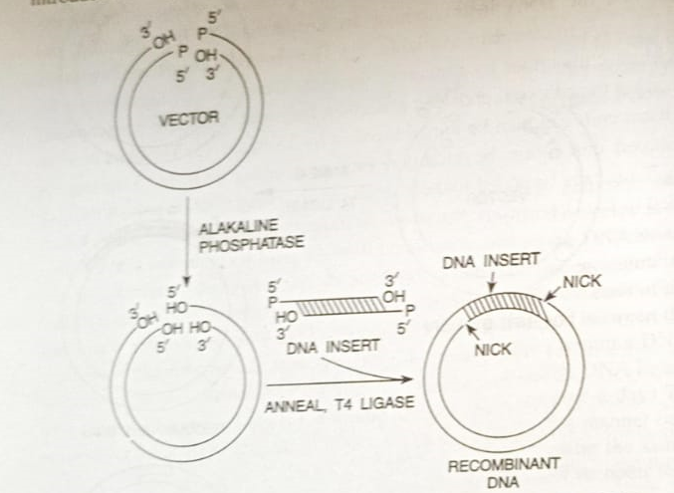

Slide 34
Both Ends Cohesive and Separately Matched
One protruding end of the vector may be compatible with one
end of the DNA insert, while the other end of vector is
compatible with the second end of the insert.
This situation arises when one end of the vector as well as that of
the DNA insert is generated by one restriction enzyme, while
their other end is cut by a different enzyme .
As earlier, the opened vector and DNA insert are mixed under
annealing conditions to allow pairing between the compatible
ends of the vector and the DNA insert, T4 ligase is then used to
seal the nicks to yield recombinant DNA.
In such a situation, only the recombinant DNA is circularized
(since the two ends of vector are unmatched as are the two ends
of DNA insert) and DNA insert is integrated in only one
orientation or direction.

Slide 35
Both Ends Cohesive and Unmatched
Often the DNA insert is prepared using one restriction enzyme,
while the vector is opened with another enzyme; this generates
cohesive ends in the vector and the DNA insert, which are
unmatched.
In this situation, the following approaches are available.
The protruding ends are converted into blunt ends either by
removing the protruding ends by digestion or by extending the recessed ends using Klenow fragment or reverse transcriptase; the blunt ends can then be joined together by T4 ligase.
(2) The blunt ends so produced can again be changed into protruding ends by 3'-tailing. A poly-T tail may be added to the 3'-ends of say, vector, while poly-A tails are added to the DNA insert; the two now have matched protruding ends, which pair together under annealing conditions to Yield recombinant DNA.

Slide 36
Often the tails are of different sizes: therefore the gaps remaining in the recombinant DNA are filled with DNA polymerase l prior to ligation.
linkers can be attached to the blunt end of the vector and the DNA insert. The linkers are cleaved with the appropriate restriction enzyme to generate protruding ends that are compatible the vector and the insert are now joined together.
In addition, appropriate adaptors may be joined to the protruding ends of the vector and/or the DNA insert to generate completely matched cohesive ends.
Both ends Flush/Blunt
Flush or blunt-ended vector and DNA insert can be joined together by T4 DNA ligase. However, high concentrations of both the enzyme, and the vector and insert DNAs are required.

Slide 37
The DNA insert gets ligated in either orientation, and it can be easily and precisely separated from the vector only if the two were cleaved by the same restriction enzyme (producing blunt ends). Alternatively, the blunt ends can be converted into cohesive ends as outlined above.
One End Cohesive and Compatible, the Other End Blunt
If the vector and the DNA insert have one compatible and cohesive end, and one flush end, their cohesive ends pair together when they are mixed under annealing conditions.
The T4 ligase seals the nick at the cohesive end and joins the blunt ends as well. It should be noted that under such a situation, only the recombinant DNAs are produced since vector and DNA insert molecules can not circularize due to their one cohesive and one blunt ends.

Slide 38
DNA ligase and ligation
DNA Ligases are enzymes that join the nucleic acid molecules
together.
They can join both DNA (DNA ligase) and RNA (RNA ligase).
. The mechanism of DNA ligase is to form two covalent
phosphodiester bonds between 3' ends of one nucleotide,
("acceptor") with the 5' phosphate end of another ("donor").
ATP is required for the ligase to work.
DNA ligases are mg++ dependent enzymes .
The most widely DNA ligase is derived from the bacteriophage T4.
Biological function:
DNA ligase repair single strand breaks or nick (discontinuities).
Ligation reactions may be blunt ended or sticky ended.
Sticky ends increase the efficiency of ligation.

Slide 39
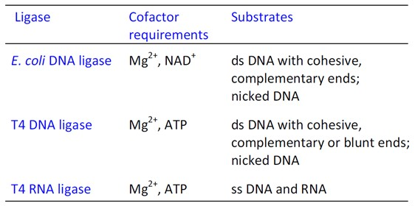
Types of DNA ligase
Two families of DNA ligases:
ATP dependent – found in eukaryotes.
NAD+ dependent- found in prokaryotes.
In mammals four types (I, II, III, IV) of DNA ligases are seen.

Slide 41
DNA SEQUENCING
Determination of nucleotide or base sequence of a DNA
molecule/fragment is known as DNA sequencing.
At present, DNA sequencing is possible for only 700-800 bp long
DNA fragments.
DNA sequencing has become feasible as a result of the following
important developments:
The availability of restriction endonucleases.
The development of highly sensitive gel electrophoresis techniques, which can separate DNA fragments differing by one nucleotide only,
The gene cloning and PCR techniques making available large quantities of individual DNA fragments, and
The development of two reliable, relatively easy and rapid DNA sequencing procedures, called
(a) Maxam and Gilbert procedure, and
(b) The enzymatic procedure

Slide 42
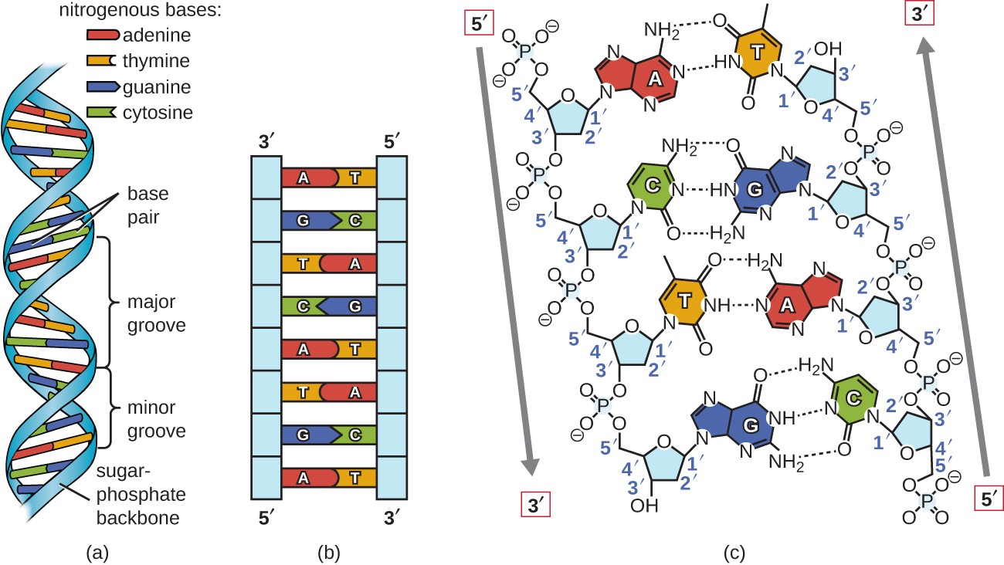
DNA STRUCTURE
In a strand of DNA, there are some simple units known as nucleotides. These nucleotides have a 'backbone' that consists of sugars and a phosphate group. The DNA bases can be one of four kinds and they are attached to these sugars. These bases hold the important and unique genetic information for body.
These bases are:
Adenine (A)
Thymine (T)
Cytosine (C)
Guanine (G)

Slide 43
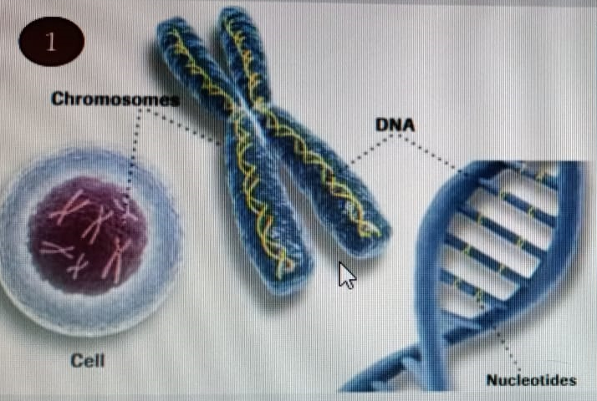

Slide 44
Maxam and Gilbert Method (Chemical degradation method)
Developed by developed by Allan Maxam and Walter Gilbert in
1976–1977.
In the first DNA sequencing technique, called Maxam and Gilbert
procedure, the DNA fragment to be sequenced is end-labeled by
the addition of ³²P-dATP either at the 5’-ends (by the enzyme
polynucleotide kinase or at the 3’-ends (by the enzyme
deoxynucleotidyl transferase of its two strands.
The end-labeled fragment is now (i) digested with a restriction
endonuclease, which cleaves it into only two fragments of
unequal lengths. As a result, only one end of each of the two
fragments thus produced will be labeled. The two unequal
fragments are separated through gel electrophoresis and they
are sequenced separately.

Slide 45
Alternatively, (ii) the end-labeled fragment is denatured and its
two complementary strands are separated through gel
electrophoresis. The samples of complementary strands thus
separated are sequenced separately. It may be noted that each
strand will be labeled at one end (either 5' or 3) only.
Procedure
The single-end-labeled double or single-stranded DNA samples
thus produced are subjected to base-specific chemical cleavage
so that in a reaction mixture cleavage occurs only at one of the
following four sites: sites having G,C,G+A or C+T.
Each DNA sample is partially digested in four separate reaction
mixtures (one each for specific cleavage at the sites of G,C,G+A or
C+T).
In these reaction mixtures, each DNA fragment strand is expected
to be cleaved, on an average only once at any one of the sites
having the particular base for which the reaction mixture is
specific.

Slide 46
The base-specific cleavage of DNA fragments involves the
following steps:
(1) modification of the concerned base,
(2) removal of the modified base from the DNA strand, and
(3) induction of strand break (break in the sugar-phosphate back-
bone) in the position from which the modified base has been
removed.
Such a cleavage generates a mixture of end-labelled DNA
fragments of variable lengths.
Digests of double-stranded DNA are denatured before they are
subjected to electrophoresis. The digests from the four reaction
mixtures are then subjected to gel electrophoresis in
separate lanes of the same gel to separate the fragments
according to their lengths.
The base sequence is determined by sequential reading of the
bands developed in the four lanes of the gel through
autoradiography

Slide 47
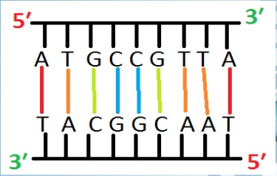
e.g. Here is a fragment of double stranded DNA, and you do not
know its sequence:
As the sequence of both strands are unknown, but if we find out
the sequence of one strand, we would get to know sequence of
other one also.

Slide 48
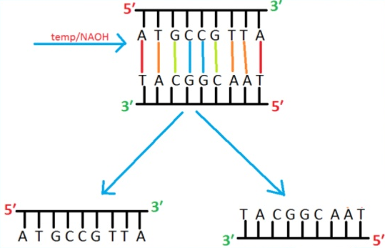
At first, the double stranded fragment is separated into two
single strands by applying high Temperature or high PH.
Run the single stranded fragments on gel.
As lighter fragment band will move further than the heavy
fragment band.

Slide 49
Take one of fragment band from the gel.
Remove the Phosphate at 5′ end and incorporate Radioactive
Phosphate 32- PO₄ enzymatically.
Now put all the radioactively labelled fragments in four tubes.
A + G
A
T + C
C

Slide 50
Tube 1 :
Increase Temperature and PH(by adding NAOH), that would
cause fragments to break down. Dimethyl sulfate will be added
that would make cuts at Adenine and Guanine positions.
Tube 2:
Dimethyl sulfate and dilute HCL will be added that would cuts the
fragment at Adenine position.
Tube 3:
Reagents Hydrazine and Piperidine are added that would cuts the
fragment at position Cytocine and Thymine.
Tube 4:
In the last tube, Hydrazine, Piperdine and NACL is added that
would cuts the fragment at Cytocine position

Slide 51
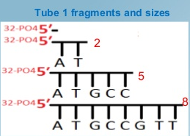
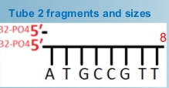
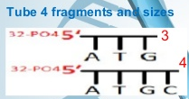
After chemical degradation, we would get following radioactively
labelled fragments from each tube:
A + G
T + C
A
C

Slide 52
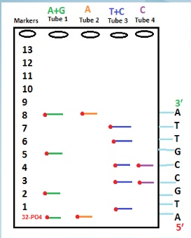
Gel electrophoresis
All of the fragments from each
four tubes are pour in Gel.
Four wells will be make on Gel,
in 1st well, fragments from 1st
tube is pour, in 2nd well
fragments from 2nd tubes and
so on.
Fragments would separate on
Gel according to size.
Smaller fragments would move
farther than larger fragments.
After placing radioactive film
on top of gel, radioactive
labelled fragments would emit
a spot at their position.

Slide 53
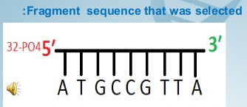
If we see the sequence on gel from 5 prime to 3 prime, and
compare it, it is the same sequence that we have at first
Advantages
• Directly read purified DNA.
• Used sequence heterogeneous
DNA as well as Homopolymeric
sequences.
• used to analyze DNA-Protein
interaction.
• Used to analyze Epigenic
modification and nucleic acid
structure.
Disadvantages
• Use of toxic chemicals and
extensive use of radioactive
isotopes highly poisonous and
unstable.
• Cannot read more than 500bp. • Setup is quite complex.
• It is difficult to make Maxam-
Gilbert DNA sequencing kit.
• Read size decrease with
incomplete cleavage reactions.

Slide 54
(b) Sanger Coulson method (Enzymatic Procedure)
(Chain Termination Method)
The second technique is an enzymatic procedure, commonly
referred to Sanger Coulson method, developed by F. Sanger and
coworkers.
Developed by Frederick Sanger and colleagues in 1977, it was the
most widely used sequencing method for approximately 25 years
after its discovery .He got NOBEL PRIZE in 1980.
In this technique, the DNA fragment to be sequenced is
denatured and the complementary strands are separated
through electrophoresis.
One of the two complementary strands (or often both the
strands, but in separate experiments) is used as template for
DNA replication catalyzed by the Klenow fragment (E. coli DNA
polymerase I minus the first of its 323 amino acids, i.e, the
sequence having 5’-- 3’- Exonuclease activity).

Slide 55
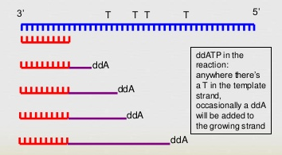
Basic Principle
This method generally is an In-Vitro synthesis of DNA strand and
by using terminators (di-deoxynucleotide) the growing strand
terminates at specific site.
Upon termination the strands are overlap to got original
sequence of unknown DNA Strand.

Slide 56
Requirements
Single Stranded template Primer
DNA polymerase
Di-Deoxynucleotide
The 3′-OH group necessary for formation of the phosphodiester
bond is missing in ddNTPs)
Every nucleotide have its specific ddNTP form i.e., ddATP, ddGTP
etc.

Slide 57
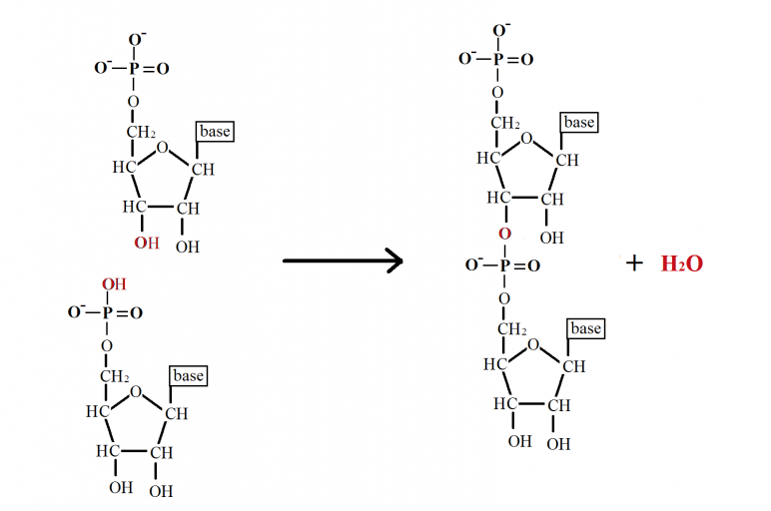
Phosphodiester Bond

Slide 58
Procedure:
Four different reaction mixtures are prepared for the replication
of each DNA strand to be sequenced.
In one of the reaction systems, 2’,3’-dideoxycytidine
triphosphate (ddCTP) is added in a concentration about 1/100th
of the normal deoxycytidine triphosphate present in the system
ddCTP acts as a terminator of the polynucleotide chain being
newly synthesized on the template strand.
Chain termination by ddCTP is achieved due to the fact that it
(and the other 2-3 dideoxynucleotides) does not have a free 3'-
OH group as a result of which further nucleotides cannot be
added to the new chain.
At the concentration used here, ddCTP would terminate the
newly synthesized polynucleotide chains at any one of all the
possible sites where cytosine is to be incorporated in the new
chain.

Slide 59
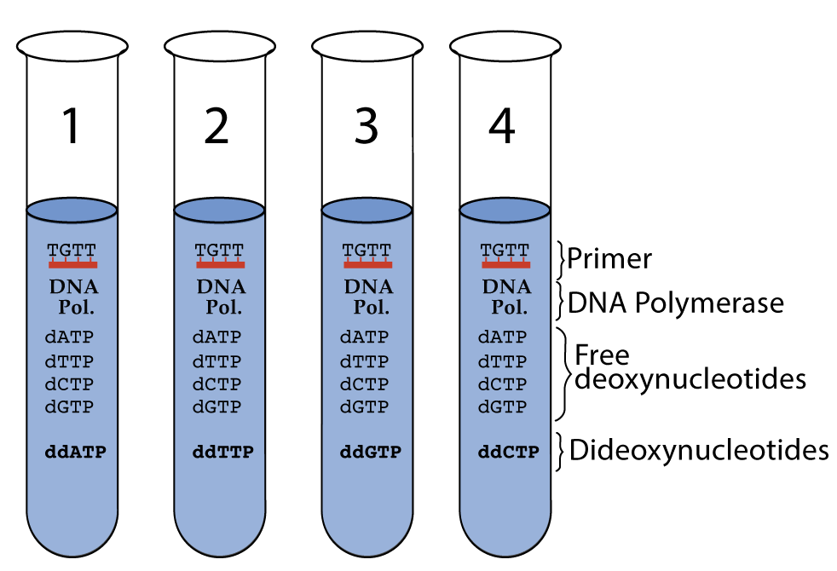
In one each of the three other reaction mixtures using the same
DNA fragment as template, 2’,3’-dideoxythymidine triphosphate
(ddTTP), 2’,3’-dideoxyadenosine triphosphate (ddATP), or 2’,3'-
dideoxyguanosine triphosphate (ddGTP) used as chain terminator
to terminate the polynucleotide chains at any line of all the
positions where T, A or G, respectively, are to be incorporated in
the new chain (each 2‘,3‘-dideory nucleotide is used in a separate
reaction mixture).

Slide 60
The partially synthesized (due to chain termination) DNA chains
from each of the above four reaction mixtures are separated
from the template strand by denaturation.
The four single-stranded samples are now separately subjected
to gel electrophoresis (in separate lanes of a gel) in order to
separate the strands according to their size.
The bands in the gels are developed onto an X-ray film through
autoradiography.
The fastest moving fragment will be the smallest one and each
subsequent band will be one nucleotide longer than the previous
one. Therefore, by comparing the bands of the four gel lanes thus
obtained, nucleotide sequence of the DNA fragment can be
determined.

Slide 61
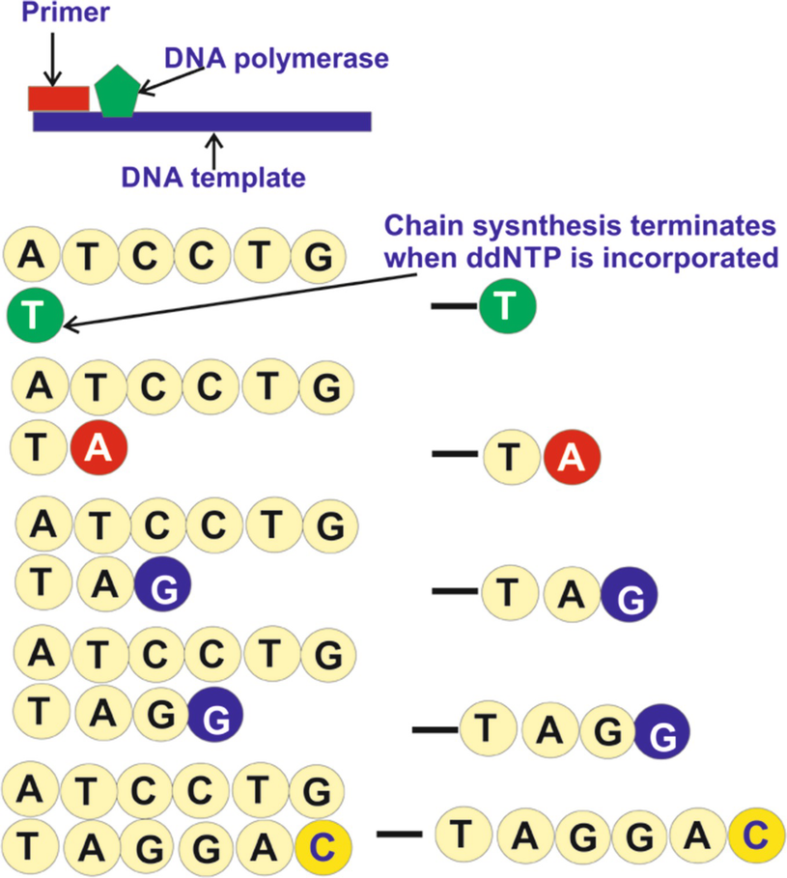
Chain Termination

Slide 62
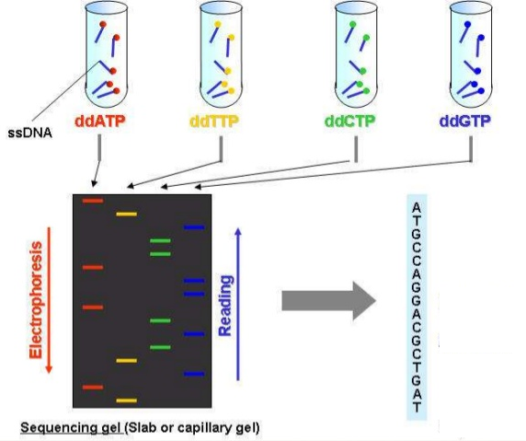
Gel electrophoresis

Slide 63
VECTORS
A Vector is a DNA molecule that has the ability to replicate
autonomously in an appropriate host cell, and into which the
DNA insert is integrated for cloning.
Therefore, a vector must have an origin of DNA replication
(denoted as ori) that functions in the host cell.
Any extra-chromosomal small genome, e.g. plasmid, phage and
virus, may be used as a vector.
Salient features of ideal vector
It should be able to replicate autonomously. When the objective of cloning is to obtain a large number of copies of the DNA insert, the vector replication must be under relaxed control so that it can generate multiple copies of itself in a single host cell.
It should be easy to isolate and purify
It should be easily introduced into the host cells, i.e., transformation of the host with the vector should be easy.

Slide 64
The vector should have suitable marker genes that allow
easy detection and/or selection of the transformed host cells.
When the objective is gene transfer, it should have the ability to
integrate either itself or the DNA insert it carries into the genome of the host cell.
6. The cells transformed with the vector containing the DNA insert (Recombinant DNA) should be identifiable or selectable from those transformed by the unaltered vector.
A vector should contain unique target sites for as many restriction enzymes as possible into which the DNA Insert can be integrated.
When expression of the DNA Insert is desired, the vector should contain at least suitable control elements, e.g., promoter, operator and ribosome binding sites.

Slide 65
It should be kept in mind that
The DNA molecules used as vectors have coevolved with their
specific natural host species, and hence are adapted to function well in them and in their closely related species. Therefore, the choice of vector depends largely the host species into which the DNA insert or gene is to be cloned. In addition,
Most naturally occurring vectors do not have all the required functions, therefore, useful vectors have been created by joining together segments performing specific functions (called modules) from two or more natural entities.
Cloning And Expression Vectors
“All vectors used for propagation of DNA inserts in a suitable host
are called cloning vectors. But when a vector is designed for the
expression of i.e. production of the protein specified by the DNA
insert, it is termed as expression vector”

Slide 66
As a rule, expression vectors contain at least the regulatory
sequences, i.e. promoters, operators, ribosomal binding sites,
etc., having optimum function in the chosen host.
When an eukaryotic gene is to be expressed in a prokaryote, the
eukaryotic coding sequence has to be placed after prokaryotic
promoter and ribosome building site since the regulatory
sequences of eukaryotic are not recognized in prokaryotes.
In addition, eukaryotic genes, as a rule, contain introns
(non coding regions) present within their coding regions. These
introns must be removed from the DNA insert to enable the
proper expression of eukaryotic genes since prokaryotes lack the
machinery needed for their removal from the RNA transcripts.
When eukaryotic genes are isolated as c DNA, they are intron-
free and, hence, suitable for expression in prokaryotes. fusion
proteins.

Slide 67
C-DNA library preparation
A DNA library is a collection of DNA clones, gathered together as
a source of DNA for sequencing, gene discovery, or gene function
studies.
There are two types of DNA libraries: c-DNA and Genomic.
A c-DNA library is a set of c-DNA clones prepared from the
mRNAs isolated from a particular type of tissue. •
The c-DNA library contains only complementary DNA molecules
synthesized from mRNA molecules in a cell.
This molecules represents all the gene that are expressed in the
cell at different stage of its development.

Slide 70
Preparation of c-DNA
A cDNA is the copy or complementary DNA produced by using
mRNA (usually) as a template. In fact, any RNA molecule can be
used to produce c-DNA.
DNA copy of an RNA molecule is produced by the enzyme reverse
transcriptase (RNA-dependent DNA polymerase, discover by
Temin and Baltimore in 1970) generally obtained from Avian
Mycloblastosis Virus (AMV).
This enzyme performs similar reactions as DNA polymerase, and
has an absolute requirement for a primer with a free 3’-OH.
When eukaryotic mRNA is used as a template, a poly-T
oligonucleotide (more specifically, oligodeoxynucleotide is
conveniently used as the primer since these mRNAs have a poly-
A tail at their ends. But special tricks are required to utilize
primers for other RNAs, e.g. prokaryotic mRNA, rRNA,RNA virus
genomes, etc.

Slide 71
For example, a poly-A tail may be added to 3’ end of the RNA to
make it analogous to eukaryotic mRNA (oligo-T is now used as
primer); this reaction is catalyzed by the enzyme poly. A
polymerase.
The appropriate oligonucleotide primer is annealed with the
mRNA, this primer will base-pair to the 3’ end of mRNA.
Reverse transcriptase extends the end of the primer using mRNA
molecule as a template.
This produces a RNA-DNA hybrid molecule, the DNA strand being
the c-DNA. The RNA strand is digested either by RNase H or
alkaline hydrolysis: this frees the single-stranded c-DNA.
Curiously, the 3'-end of this c-DNA serves as its own primer and
provides the free 3’-OH required for the synthesis of its
complementary strand; therefore, a primer is not required for this
step.

Slide 72
The complementary strand of c-DNA single strand is synthesized
by either the reverse transcriptase itself or by E. coli DNA
polymerase I.
This generates a hairpin loop in the c-DNA. The hairpin loop is
cleaved by a single strand specific nuclease to yield a regular DNA
duplex.

Slide 73
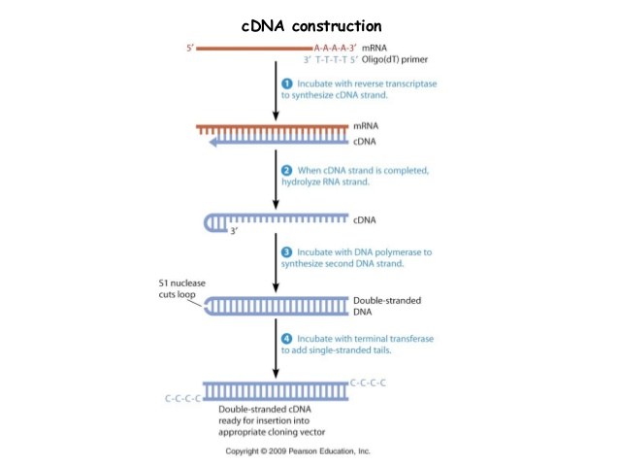

Slide 74
Vectors used in genetic engineering
Plasmid
Types of Plasmid Vectors
There are several types of bacterial plasmids, but following
three types are widely studied and used in genetic engineering.
F plasmids are responsible for conjugation and are also called
conjugative or transmissible plasmids. Due to their presence the bacterial cells behave as male.
R plasmids carry genes for resistance to antibiotics.
Col plasmids carry genes for coding colicins, the proteins that act as bacteriocin and kill sensitive E. coli cells.

Slide 75
Characteristics of a Plasmid Vector
A suitable plasmid vector must have following characteristics:
It must have minimum amount of DNA.
It must have relaxed replication control.
It should have at least two suitable markers for identification.
It should be easily isolated from the cell.
It should possess a restriction site for one or more restriction enzymes.
Insertion of a foreign DNA molecule as one of these restriction sites does not alter its replication property.
The unique restriction site must be located within one of the two selectable markers.

Slide 76
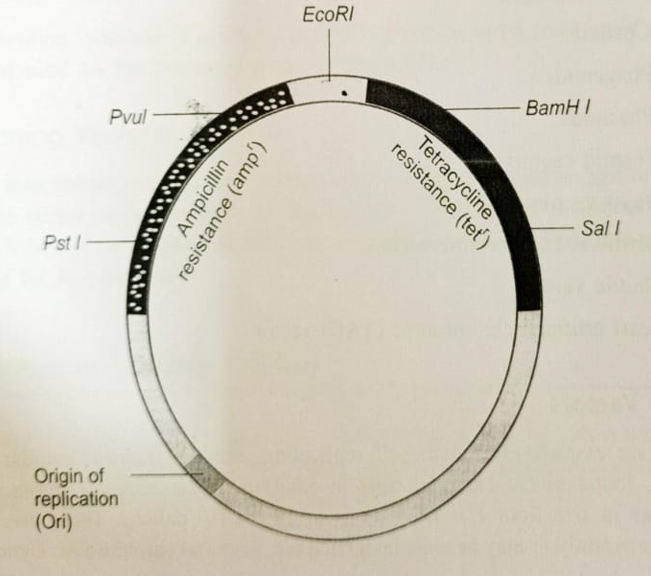

Slide 77
Examples of Plasmid Vectors
Plasmids having all the above mentioned characters have been prepared by modifying naturally occurring plasmids by in vitro techniques. Some of such plasmids are:
pBR322 Plasmid Vector
The name pBR is derived from
(i) p that denotes plasmid, (ii) B is from the name of scientist, Boliver and (ii) R from Rodriguez.
These two scientists developed this plasmid.
The numeral 322 distinguishes this plasmid from other plasmids developed in the same laboratory later on, such as pBR325, pBR327, pBR328, etc.
pBR322 is a reconstructed plasmid. It is most widely used plasmid having 4362 base pairs. Its entire base sequence is known. It is constructed from three plasmids and has following regions:

Slide 78
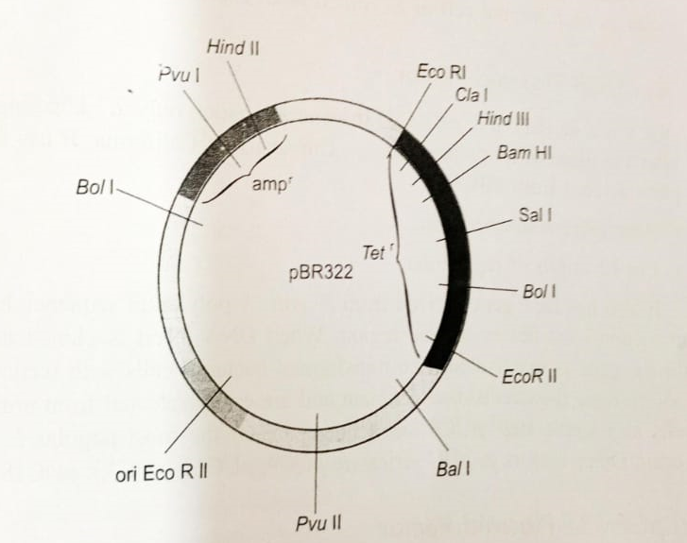
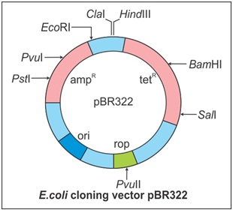

Slide 79
Origin of Replication: It is derived from plasmid _{P}MBI. This plasmid is closely related to naturally occurring plasmid Col El.
Gene Conferring Resistance to Antibiotics Ampicillin (amp^{r}) and Tetracycline (tet^{r}): Gene amp^{r} is derived from plasmid RI and gene tet^{r} from plasmid R6.5. Both are natural populations of antibiotic resistant plasmids. These genes are used as markers.
Unique Recognition Sites for 20 Restriction Endonucleases: Some of these sites lie within the markers amp^{r} and tet^{r} genes. The presence of restriction sites within markers tet^{r} and amp^{r} permits an easy selection of transformed cells having recombinant PBR322. Insertion of foreign DNA fragment into the plasmid using restriction enzyme Pst I or Pvu 1 places the DNA insert (foreign DNA) within the marker gene amp^{r}. The DNA insert (foreign DNA) within the marker gene amp^{r} makes it nonfunctional.

Slide 80
Bacterial cells with such a recombinant pBR322 will be unable to grow in the presence of ampicillin but will grow successfully on tetracycline. Similarly, when restriction enzyme Bam HI or Sal I is used, the DNA insert is placed within the marker gene tet^{r}. This makes tetracycline gene nonfunctional. Transformed bacterial cells possessing such a recombinant pBR322 will multiply on ampicillin but not on tetracycline. This process allows an easy selection of a single bacterial cell having recombinant DNA.
(iv) Nic-bom Region: PBR322 has a nic-bom region (bom basis of mobility). It is responsible for mobilization or cell to cell transfer of the plasmid. This region interferes with the replication efficiency of extra chromosomal DNA in monkey cells.

Slide 81
Useful Features of pBR322
The useful features of this plasmid are:
Small size (4.4 kb) enables easy handling, purification and
manipulation.
Two selectable markers amp^{r} and tet^{r} permit easy
selection of recombinant DNA.
About 15 copies of them occur per cell which can be increased to
1,000 to 3,000 when protein synthesis is blocked.
It is a cloning vector.
pBR327 has more advantageous features than plasmid pBR322,
Its 30-40 copies occur in each normal cell of E. coli. It is an
expression plasmid.

Slide 82
(b) pUC18 Plasmid Vector
pUC8 is a derivative of pBR322.
It is much smaller, only 2.7 kbp long.
It is named after the place of its preparation i.e., University of
California.
It has following two parts derived from pBR322:
1. Ampicillin resistance gene.
2. Col El origin of replication.
It also has lacZ gene derived from E. coli. A polylinker sequence
having unique restriction sites lies in the lac region.
When DNA insert is cloned in this region the lac gene is
inactivated.
The transformed bacterial cells with recombinant DNA molecule
are B-galactosidase deficient and are easily selected from normal
bacterial cells in a single step.
pUC8 has become one of the most popular E coli cloning vector.
Other vectors in pUC series are pUC 9 pUC12, pUC18 and pUC19.

Slide 83
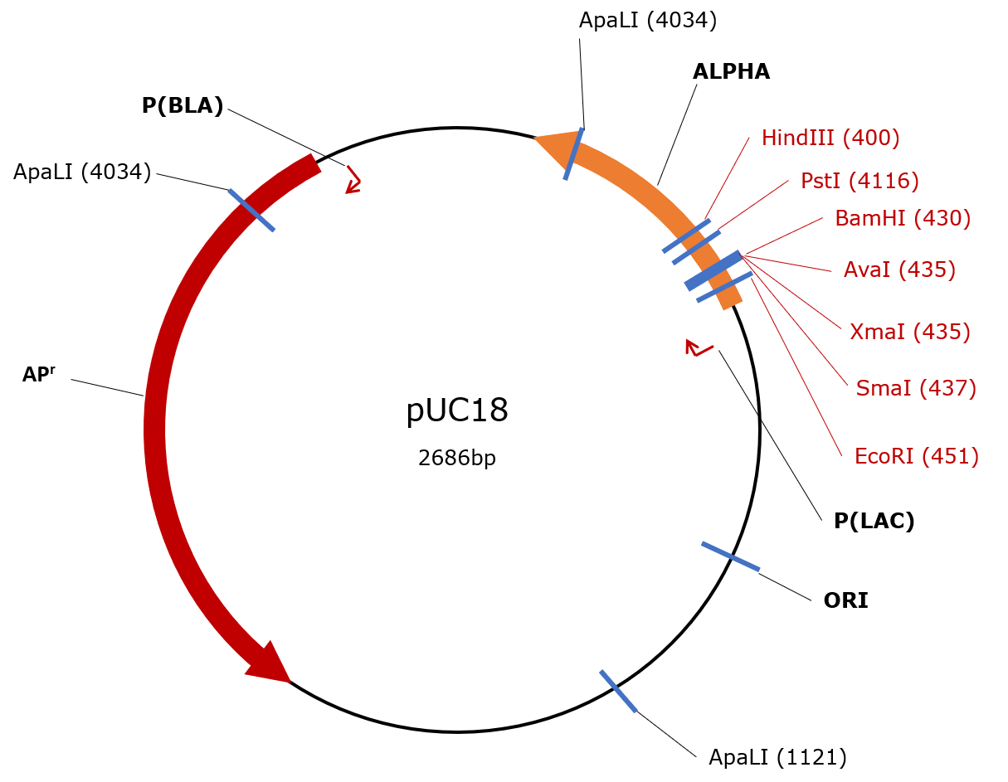

Slide 84
Bacteriophages : lambda
Bacteriophage Vectors
Bacteriophages are viruses that attack bacteria.
Several bacteriophages are used as cloning vectors.
The most commonly used E. coli phages are 2 (lambda) phage
and M13 phage.
Phage vectors have following three advantages over plasmid
vectors:
Phage vectors are more efficient than plasmids for cloning large
DNA fragments. Foreign DNA up to 25kb in length can be inserted into phage vector.
DNA can be packed in vitro into phage particles and transduced into E. coli with high efficiency.
It is easy to screen and to use in the storage of recombinant DNA.

Slide 85
Examples of Bacteriophage Vectors
(Lambda) Phage Vectors
The genome of λ-phage is 48502 bp long, i.e. about 49 kb and has 50 genes, About half of these genes are essential. The genome remains linear in the phage head and has single-stranded protruding cohesive ends of 12 bases (5'GGGCGGCGACCT...3’ and 3’ CCCGCCGCTGGA.. 5’).
The two cohesive ends anneal to form circular DNA molecule. The sealed cohesive ends form a cos site. It is the site of cleavage of phage DNA.
For packaging in the phage head of bacteriophage, the A-DNA must be larger than 38kb and smaller than 52 kb. The genes for lysogeny are located in the middle part of λ-phage genome.
For creating lambda phage vectors, this segment is removed wholly or partially. This allows the vector to accommodate large DNA inserts and avoids chances of lysogeny.

Slide 86
Several vectors have been produced from wild type lambda genome by mutation and recombination as well as by recombinant DNA techniques.
Features of phage Vectors:
These vectors have following two basic features:
The vector can be propagated as phages in E. coli cells enabling preparation of vector DNA.
They contain restriction sites, which allow removal of lysogenic segment and provide insertion site for the DNA fragment to be cloned.
Types of λ-Vectors:
The various λ vectors are classified into two categories.
Insertion vectors and
Replacement vectors

Slide 87
Insertion Vectors:
In case of an insertion vector, a portion of non essential region is deleted and two arms of λ genome are ligated.
The foreign DNA is inserted at the unique restriction site.
The DNA insert does not affect the functioning of phage.
The insertion vector is of the size about 35 kb or more.
It can have a DNA insert of up to 18 kb.
Examples of insertion vectors are λgt10, λgt11, and λZAPII, etc.
λgt 10 is 43kb double-stranded DNA for cloning DNA fragments of about 7kb long. The insertion of foreign DNA inactivates cl (repressor) gene.
λgt 11 is 43.7kb double-stranded DNA. It can clone less than 6kb long foreign DNA. It is an expression vector. Its inserted DNA is expressed as B-galactosidase fusion protein.

Slide 88
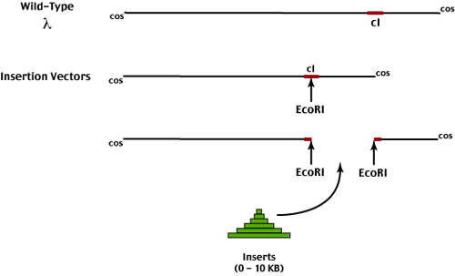

Slide 89
Replacement Vectors:
In replacement phage vector, the nonessential part of λ phage DNA is substituted by foreign DNA. The deleted region is called the stuffer fragment.
Replacement vectors have two recognition sites for the restriction enzyme used for cloning. These sites flank the stuffer region.
The maximum size of DNA insert depends upon how much of phage DNA is non-essential. Usually 20-25kb of genome is nonessential and can be replaced with foreign DNA.
EMBL3 and EMBL4 are two replacement vectors that are designed for replacing the central nonessential part of 44kb by foreign DNA of about 20-23kb length.
These replacement vectors are used mainly for preparing genomic libraries of eukaryotic genome with cloned fragments.

Slide 90
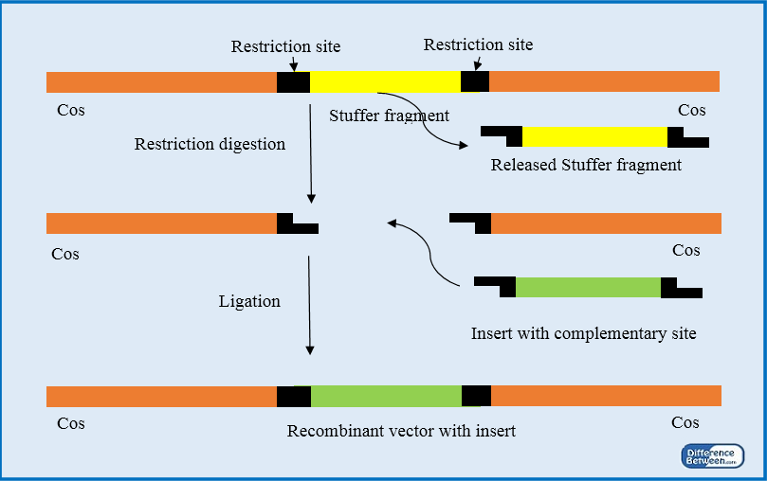

Slide 91
Cosmid Vectors
Cosmids are hybrid vectors derived from plasmids having a
fragment of a phage DNA with its cos site (the sequence yielding
cohesive ends) and sequence needed for binding of and cleavage
by terminase.
These have minimum 250bp of a DNA.
Structure of Cosmid
A typical cosmid vector has following regions:
Origin of replication.
Unique restriction site for cleavage and insertion of foreign DNA.
A selectable marker from a plasmid, coding for antibiotic resistance.
Cos site/sites from lambda phage has 12 bases. It enables recombinant DNA to be packed in lambda particle in vitro due to circulation and ligation.

Slide 92
Characteristics of Cosmid Vectors
The typical features of a cosmid vector are:
• Cosmids have a length of about 5kb. They can be used to clone
DNA inserts of up to 40-45kb.
• These can be packaged into λ-particles which infect host cells.
• Packaged cosmids infect host cells like λ-phage particles but
multiply and propagate like plasmids.
• Selection for recombinant DNA is based on the procedure used
for selection of plasmids.
• Cosmid vectors are amplified and maintained in the same way as
the plasmids.
Modern cosmid vectors belonging to pWE and sCos have
Multiple cloning sites (MCS) for simple cloning using unselected
DNA fragments.
Phage promoters flanking MCS to generate RNA copies of DNA inserts.

Slide 93
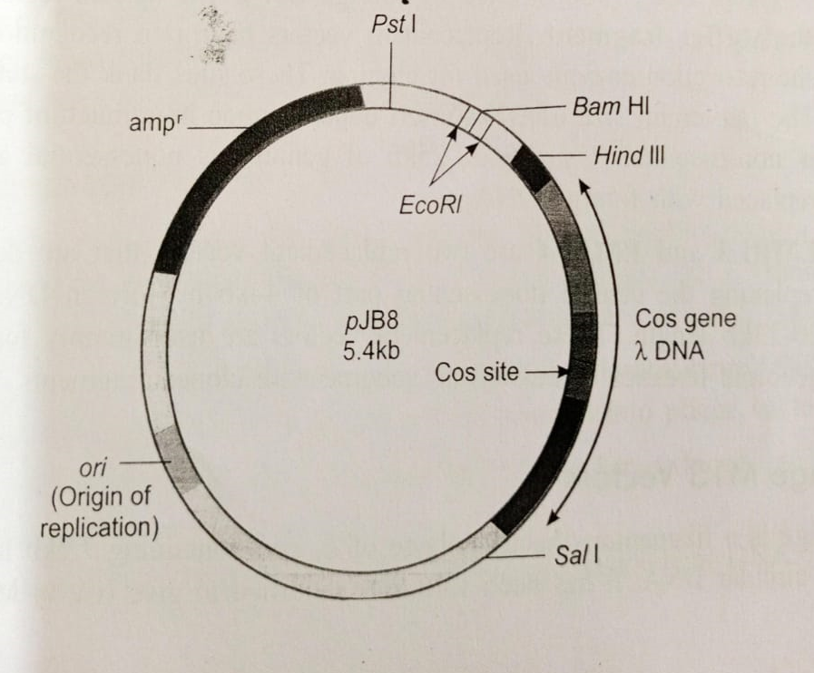
(3) Unique restriction sites (Not l, Sac ll or Sfi Ill) for cutting restriction enzymes and flank MCS, and
Vector may contain mammalian expression modules which may code dominant selectable markers for gene transfer to mammalian cells.
Use of Cosmids
Cosmids are used for the construction of genomic libraries of
Eukaryotes.

Slide 94
Artificial Chromosome Vectors
Artificial chromosome vectors are linear or circular shuttle
vectors that occur as 1 or 2 copies per cell.
They allow cloning of base sequences that are several
hundred kilobase pairs (up to 1,000 kbp or more).
These are of following types:
Bacterial artificial chromosome (BAC)
Yeast artificial chromosome (YAC)
Pl-derived artificial chromosome (PAC)
Mammalian artificial chromosome (MAC)
Human artificial chromosome (HAC)
Of these vectors YAC is used for cloning in yeast cells, BAC and PAC
in bacteria and MAC and HAC are used for cloning in mammalian
and human cells.

Slide 95
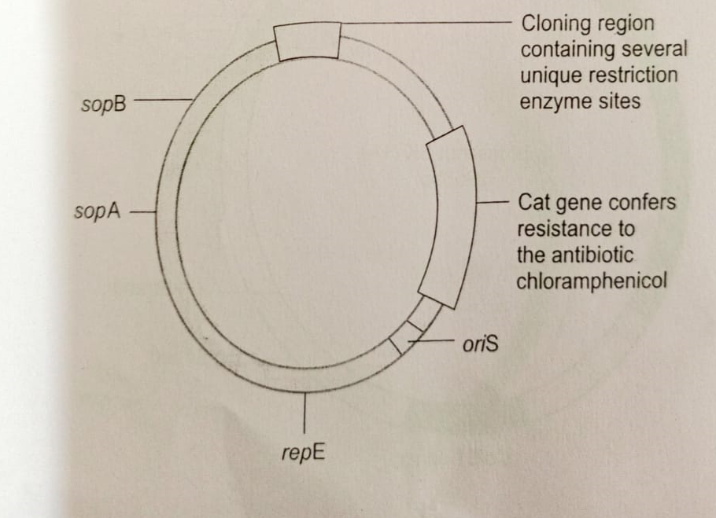

Slide 96
Bacterial Artificial Chromosome (BAC) Vector
BAC vectors are shuttle plasmid vectors, created for cloning
large-sized foreign DNA.
They have origin or replication (oriS) from bacterium E. coli
F-factor.
This maintains a strict control on the copy number of vectors to
one or two per cell.
The low copy number of BAC avoids any possibility of
recombination between different DNA inserts of multiple
vectors.

Slide 97
Structure:
The first BAC vector was pBAC108L. Other BAC vectors are pBeloBAC11. pBACe 3.6, etc. The vector pBeloBAC11has 7:4kb and allows selection of recombinant clones by lacZα complementation. It has following modules:
ori S origin of replication from E coli F1 plasmid
rep E encodes a replication protein that binds to oriS to initiate
replication.
CM chloramphenicol resistance as a marker.
cos N lambda phage cos site.
lac z, B-galactosidase gene as a restriction site.
T7 from bacteriophage for T7 RNA polymerase driven promoter.
SP6, bacteriophage SP6 RNA polymerase driven promoter.
par A, par B and par C for the division of F plasmid during cell
division.
lox P site on phage P1 genome for recombination.

Slide 98
Importance of BAC Vectors:
BAC vectors have emerged as more popular cloning vectors because of the following features:
• BAC vectors can clone DNA inserts of up to 300kb.
• They are stable and more user friendly.
• They do not suffer from chimerism caused by variation in cloned
DNA by recombination
• The low copy number of BAC vectors per host cell maintains DNA
inserts in their original form. It also avoids counter section of
cloned genes.
• BAC vectors are extensively used in the analysis of genomes.
The host for BAC vectors is a mutant strain of E.coli in which normal
restriction and modification sites are missing.

Slide 99
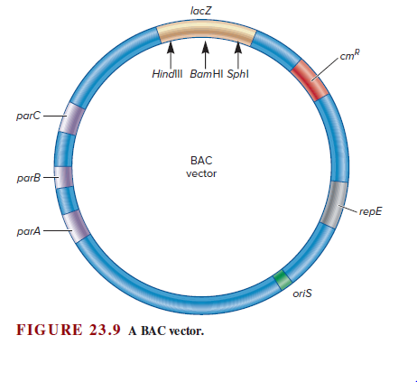

Slide 100
Yeast Artificial Chromosome (YAC) Vectors
YAC are linear plasmid vectors that behave like a yeast
chromosome. Each YAC occurs in two forms. The circular form
grows in bacteria and linear form multiplies in yeast cells.
A typical YAC (e.g. pYAC3) contains following functional modules
from yeast chromosome:
ARS sequence for replication.
CEN4 sequence for centromeric function.
Telomeric sequences from yeast chromosome at the two ends against exonuclease action, consisting of 20-70 tandem repeates of 6 bases, 5'... CCCCAA.... 3’.
TRP1 and URA3 as the two selectable markers.
Sequences from E. coli plasmid for selection and propagation of E. coli.
SUP4, a selectable marker where DNA insert is integrated.

Slide 101
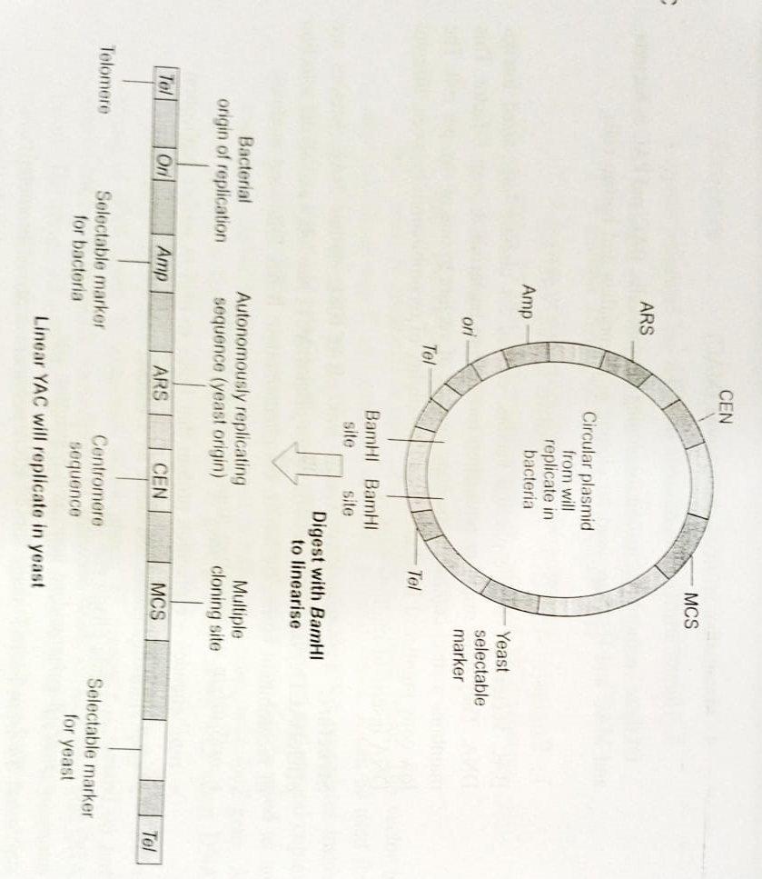

Slide 102
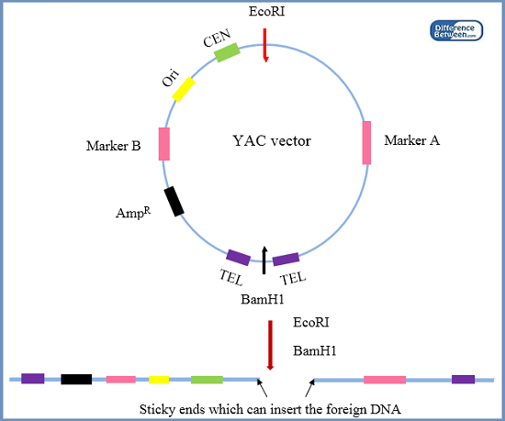

Slide 103
The first YAC vector developed was pYAC3. It is essentially a
pBR322 plasmid vector into which above mentioned yeast
sequences have been integrated.
It propagates in E. coli in circular form.
The DNA insert is integrated within SUP4 to generate linear YAC
vector.
The recombinant YAC is introduced into TRPI⁻ and URA3⁻ yeast
cells by protoplast transformation.
The recombinant clones are identified by the insertional
inactivation of SUP4 detected by a simple color test.
YACs can accommodate up to 2,000kb of cloned DNA inserted
into the multiple cloning site. Therefore, YACs are used for
cloning very large (100- 1,400kb) DNA segments.
They help in mapping complex eukaryotic chromosomes

Slide 104
But they have two disadvantages:
• Cloning efficiency is very low about 1,000 clones per ug DNA.
Thus, they can not be used for complete generation of genomic
libraries.
• It is not possible to recover large amount of pure insert DNA
from individual clones.

